Slide 1
Sum of Squared Error Technique
Devansh Awasthi (ENG17CS0065)
Deepak Purohit (ENG17CS0062)
BVM Anirudh (ENG17CS0048)

Slide 2
INTRODUCTION
The least squares technique for estimating regression coefficients minimizes this statistic, which measures the error not eliminated by the regression line.
For any line drawn through a scatter plot of data, several ways can be used to determine which line fits the data best. One method used to compare the fit of lines is to calculate the SSE (sum of the squared errors, or deviations) for each line. The lower the SSE, the better the fit of the line to the data.
Calculating the SSE enables you to calculate the treatment sum of squares (SSTR) and total sum of squares (SST). When you compute SSE, SSTR, and SST, you then find the error mean square (MSE) and treatment mean square (MSTR), from which you can then compute the test statistic.

Slide 3
SSE is a measure of sampling error. This refers to the fact that the values computed from a sample will be somewhat different from one sample to the next.
When you have a set of data values, it is useful to be able to find how closely related those values are. You need to get your data organized in a table, and then perform some fairly simple calculations. Once you find the SSE for a data set, you can then go on to find the variance and standard deviation.
Clustering
A process of organizing objects into groups such that data points in the same groups are similar to the data points in the same group. A cluster is a collection of objects where these objects are similar and dissimilar to the other cluster.

Slide 4
K-Means
K-Means clustering is a type of unsupervised learning. The main goal of this algorithm to find groups in data and the number of groups is represented by K. It is an iterative procedure where each data point is assigned to one of the K groups based on feature similarity.
K-Means algorithm starts with initial estimates of K centroids, which are randomly selected from the dataset. The algorithm iterates between two steps assigning data points and updating Centroids.

Slide 5
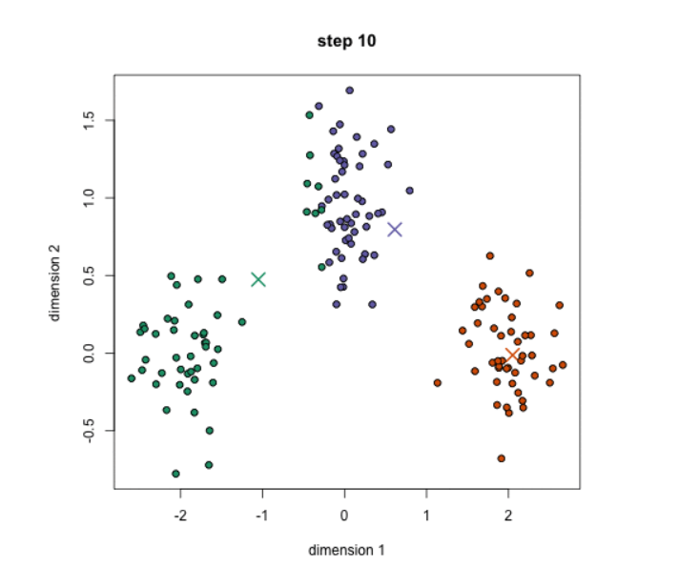
Data Assignment
In this step, the data point is assigned to its nearest centroid based on the squared Euclidean distance. Let us assume a Cluster with c as centroid and a data point x is assigned to this cluster, based on the distance between c,x. There are some other distance measures like Manhattan, Jaccard, and Cosine which are used based on the appropriate type of data.
Centroid Update
Centroids are recomputed by taking the mean of all data points assigned to a particular cluster.

Slide 6
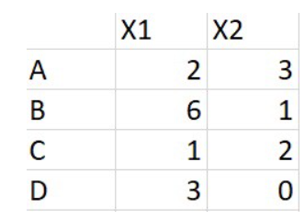
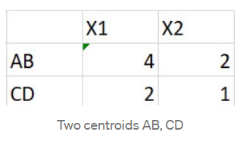
Let us go through the above steps using the example below.
1. Consider 4 data points A,B,C,D as below
2. Choose two centroids AB and CD, calculated as
AB = Average of A, B
CD = Average of C,D

Slide 7
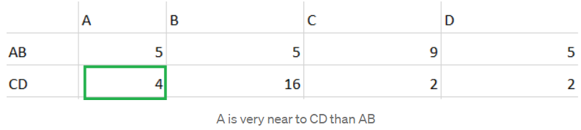
3. Calculate squared euclidean distance between all data points to the centroids AB, CD. For example distance between A(2,3) and AB (4,2) can be given by s = (2–4)² + (3–2)².
4. If we observe in the fig, the highlighted distance between (A, CD) is 4 and is less compared to (AB, A) which is 5. Since point A is close to the CD we can move A to CD cluster.

Slide 8
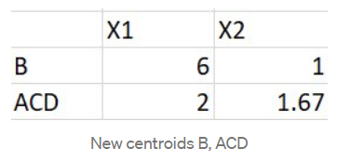
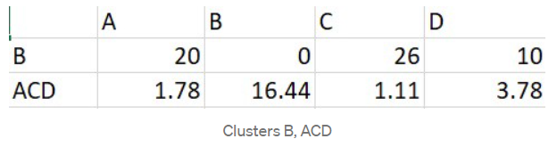
5. There are two clusters formed so far, let recompute the centroids i.e, B, ACD similar to step 2.
ACD = Average of A, C, D
B = B
6. As we know K-Means is iterative procedure now we have to calculate the distance of all points (A, B, C, D) to new centroids (B, ACD ) similar to step 3.
7. In the above picture, we can see respective cluster values are minimum that A is too far from cluster B and near to cluster ACD. All data points are assigned to clusters (B, ACD ) based on their minimum distance. The iterative procedure ends here.
8. To conclude, we have started with two centroids and end up with two clusters, K=2.

Slide 9
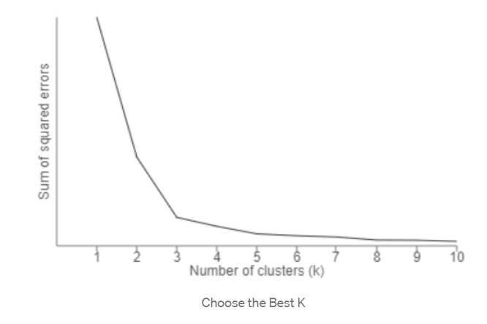
Choosing K
One method of choosing value K is the elbow method. In this method we will run K-Means clustering for a range of K values lets say ( K= 1 to 10 ) and calculate the Sum of Squared Error (SSE). SSE is calculated as the mean distance between data points and their cluster centroid.
Then plot a line chart for SSE values for each K, if the line chart looks like an arm then the elbow on the arm is the value of K that is the best

Slide 10
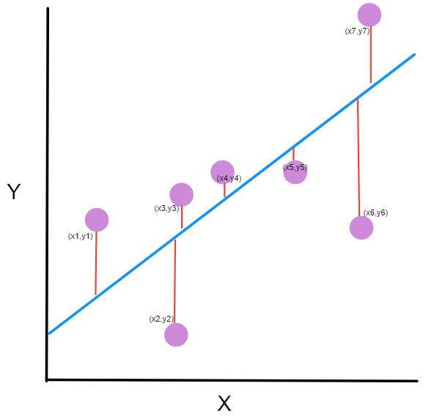
Our goal is to find a line that minimizes the squared distances to these different points.

Slide 11
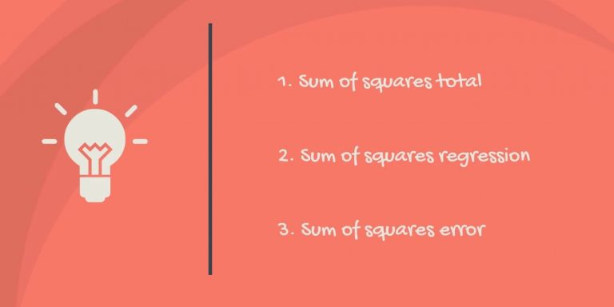
Types Of Sum Of Squared Error
In regression analysis, the three main types of sum of squares are the total sum of squares, regression sum of squares, and residual sum of squares.

Slide 12
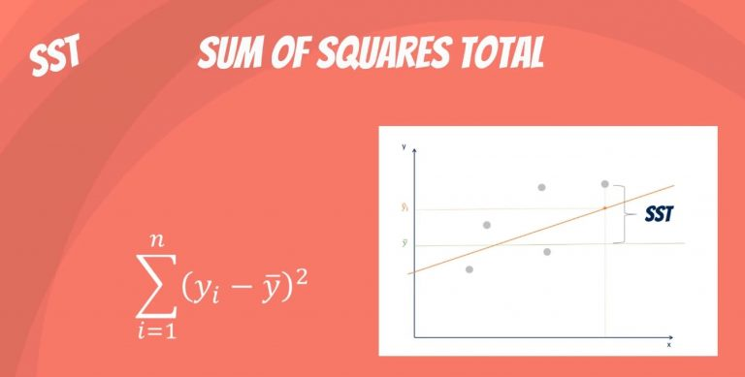
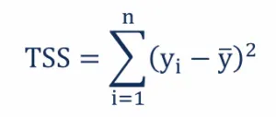
(1) Total Sum Of Squares
The total sum of squares is a variation of the values of a dependent variable from the sample mean of the dependent variable. Essentially, the total sum of squares quantifies the total variation in a sample. It can be determined using the following formula:
Where:
y_{i} – the value in a sample
ȳ – the mean value of a sample

Slide 13
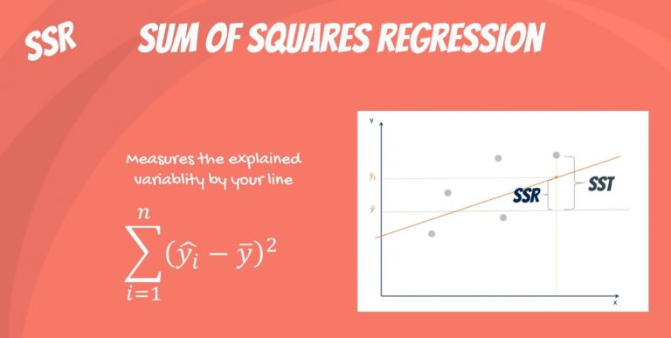
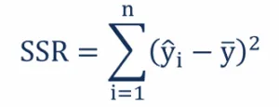
(2) Regression Sum Of Squares
The regression sum of squares describes how well a regression model represents the modeled data. A higher regression sum of squares indicates that the model does not fit the data well.
The formula for calculating the regression sum of squares is:
Where:
ŷ_{i} – the value estimated by the regression line
ȳ – the mean value of a sample

Slide 14
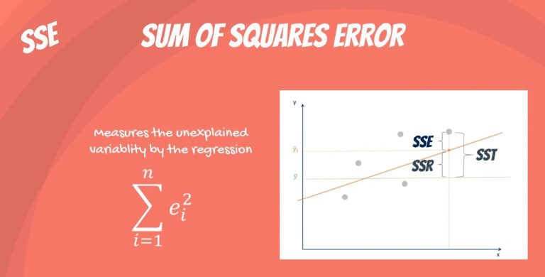
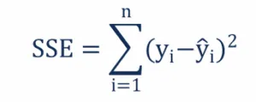
(3) Residual Sum Of Squares Or Sum Of Squares error
The residual sum of squares essentially measures the variation of modeling errors. In other words, it depicts how the variation in the dependent variable in a regression model cannot be explained by the model. Generally, a lower residual sum of squares indicates that the regression model can better explain the data while a higher residual sum of squares indicates that the model poorly explains the data.
The residual sum of squares can be found using the formula below:
Where:
y_{i} – the observed value
ŷ_{i} – the value estimated by the regression line

Slide 15
Consider the following data samples
Example Problem
Values
99.0
98.6
98.5
101.1
98.3
98.6
97.9
98.4
99.2
99.1

Slide 16
Mean (𝝁) = 𝚺 Value / number of samples
= (99.0 + 98.6 + 98.5 + 101.1 + 98.3 + 98.6 + 97.9 + 98.4 + 99.2 + 99.1) / 10
= 98.87
Step 1:
Calculate Mean of the data samples

Slide 17
Step 2:
Calculate individual error measurements
Values | Deviation
99.0 | 99.0 - 98.87 = 0.13
98.6 | 98.6 - 98.87 = -0.27
98.5 | 98.5 - 98.87 = -0.37
101.1 | 101.1 - 98.87 = 2.23
98.3 | 98.3 - 98.87 = -0.57
98.6 | 98.6 - 98.87 = -0.27
97.9 | 97.9 - 98.87 = -0.97
98.4 | 98.4 - 98.87 = -0.47
99.2 | 99.2 - 98.87 = 0.33
99.1 | 99.1 - 98.87 = 0.23
The error is the difference between the measurement and the mean.

Slide 18
Step 3:
Calculate Square of Errors
Values | Deviation | Deviation²
99.0 | 0.13 | 0.13² = 0.0169
98.6 | -0.27 | -0.27² = 0.0729
98.5 | -0.37 | -0.37² = 0.1369
101.1 | 2.23 | 2.23² = 4.9729
98.3 | -0.57 | -0.57² = 0.3249
98.6 | -0.27 | -0.27² = 0.0729
97.9 | -0.97 | -0.97² = 0.9409
98.4 | -0.47 | -0.47² = 0.2209
99.2 | 0.33 | 0.33² = 0.1089
99.1 | 0.23 | 0.23² = 0.0529

Slide 19
Sum of Square of Error (SSE)
= 0.0169 + 0.0729 + 0.1369 + 4.9729 + 0.3249 + 0.0729 + 0.9409 + 0.2209 + 0.1089 + 0.0529
= 6.921
Step 4:
Calculate the sum of square of error

Slide 20

THANK YOU !!!

